Slide 1

Capstone Project Vehicle Insurance Claim Fraud
Problem Statement
Christine Hagan
7/24/2023

Slide 2
Problem Statement Worksheet (Hypothesis Formation)
How can Vehicle Insurance company reduce payment on fraudulent claims from the population mean (6%) to (4.5%) by defining rules to flag a claim for audit with a False Positive Rate (< 5).
H
1
Context
4
Constraints within solution space
Vehicle Insurance Claim Fraud cost the industry $9.23M annually. We have tasked to find specific combinations of features that are more likely to be a fraudulent claim than the average 6% at be assigned agents for investigation.
Only have 3 years of historical data to formulate rules, therefore, will need to continue to verify that rules are affective.
2
Criteria for success
5
Stakeholders to provide key insight
Put into process a procedure that identifies high probability of fraudulent claims and reduces the overall fraud payout by 1.5% to at most 4.5%.
Manager of fraud department.
Manger of Claim processors.
3
Scope of solution space
6
Key data sources
This is for Vehicle Insurance Claims Fraud only and the region where the data was attained.
The method for determining the most important categories remains the same but as how people commit fraud evolves every other year it should be reapplied every few years.
This dataset can be found on kaggle - [Vehicle Insurance Claim Fraud Detection]
(https://www.kaggle.com/datasets/shivamb/vehicle-claim-fraud-detection/code?select=fraud_oracle.csv "Fraud detection use-case for vehicle insurance industry")
H
D
E
I
P
Notes:
Hypothesis: Create a Hypothesis with an emphasis on SMART principles. (S – Specific, M – Measurable, A – Achievable, R – Realistic, T – Timebound). If you cannot do this, you do not have a good grasp on the business problem. [State in a form of a question? How? What?]
Context: With context, we have clearly identified the problem at hand and have elucidated on how our initiative may solve this problem, alongside the commercial implications this will have on the business.
Criteria for Success: Clearly defining the criteria for success ensures that the scope of your work is clearly defined and understood. Otherwise, if this isn’t defined – your work will never end which will result in mismatched expectations.
Scope of Solution Space: Scoping out the solution space ensures that the business initiative is SPECIFIC for a certain segment or area. This prevents solutions that have been developed being scaled and applied for all other business units that the solution may not be responsible or scalable for.
Constraints within Solution Space: Looking forward, what are the foreseeable problems we are likely to encounter? Could this be stakeholder resistance? Could this be we don’t have access to the right data?
Stakeholders to provide key insight: Who are the people I need to speak to, to get the answers I need for my data analysis?
What key data sources are required?
Based off my discussions with the key stakeholders – can we clearly list out all the data sources we need so we can make a highly targeted request as opposed to a scatter-gun approach where we ask for a bit of everything?

Slide 3
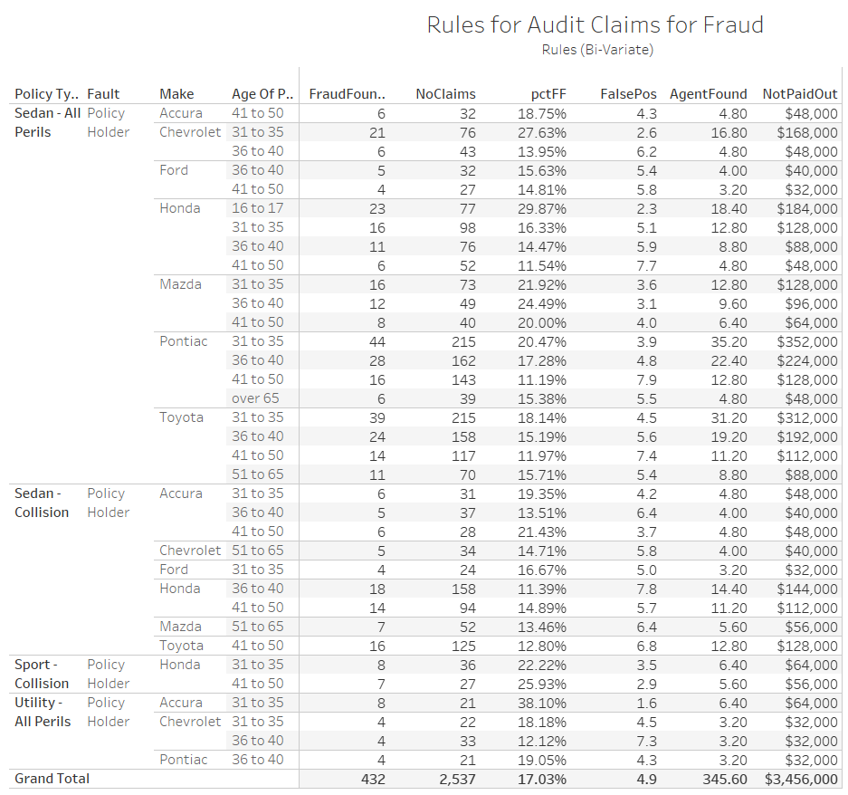
Issue Tree: Is the ‘Rules table’ in presentation

